Slide 1
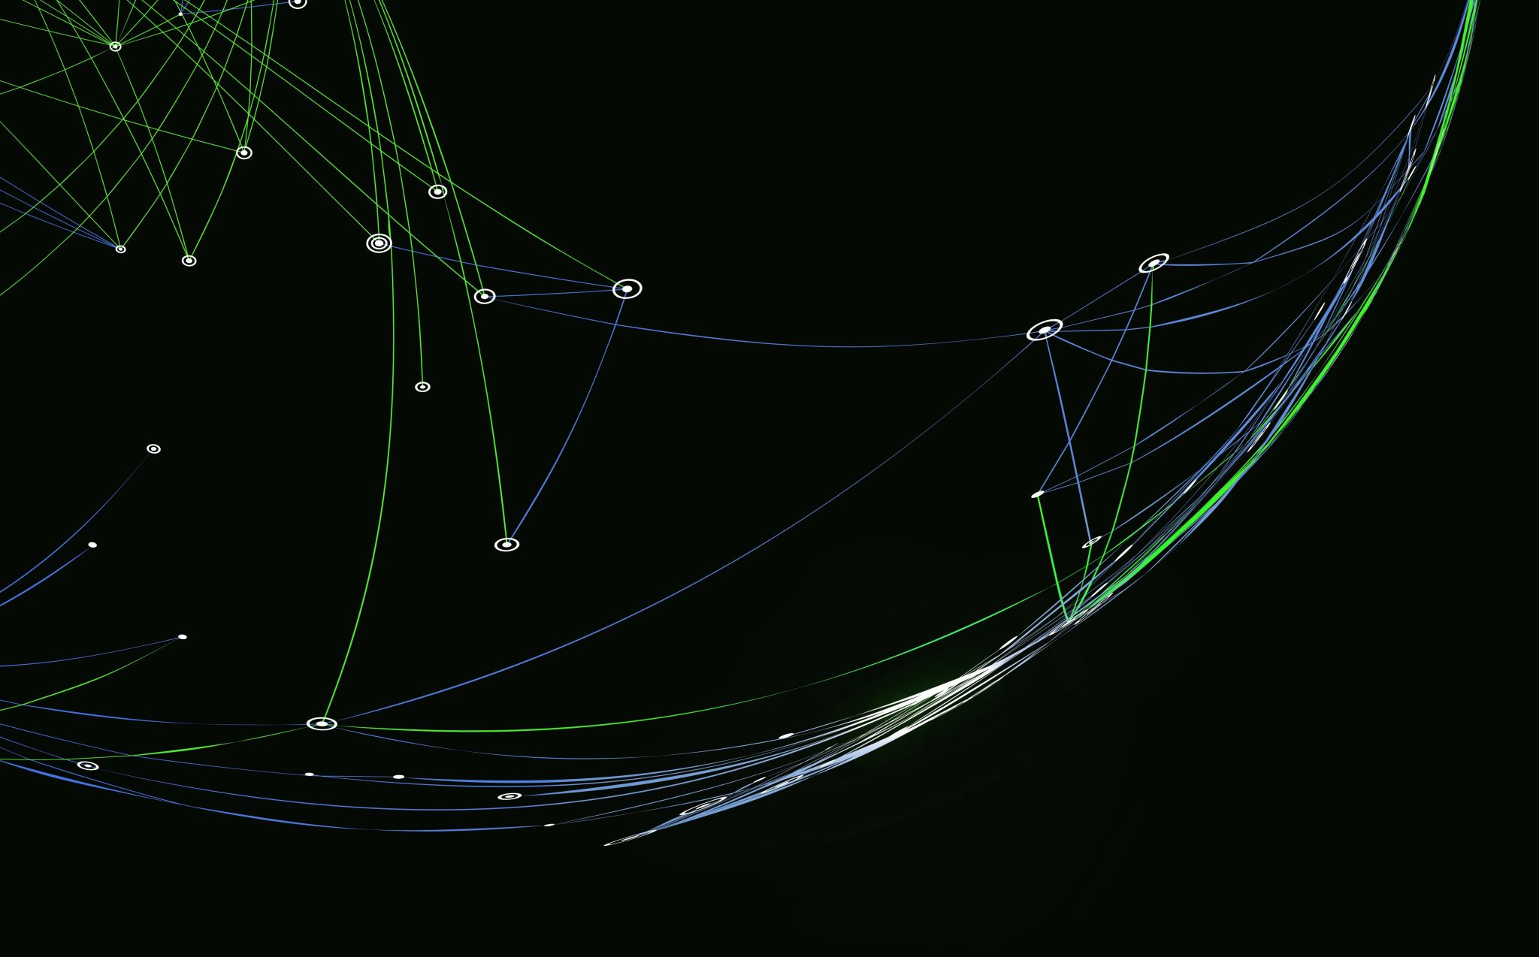
Finishing the template we started

Slide 2
Task
Finish “Fade-in” description demo.
Finish template by adding in the different styles that we have went through e.g., polaroid and “Fade-in” descriptions.
Have students personalise their website e.g., changing the text, changing the images, etc.

